Slide 1
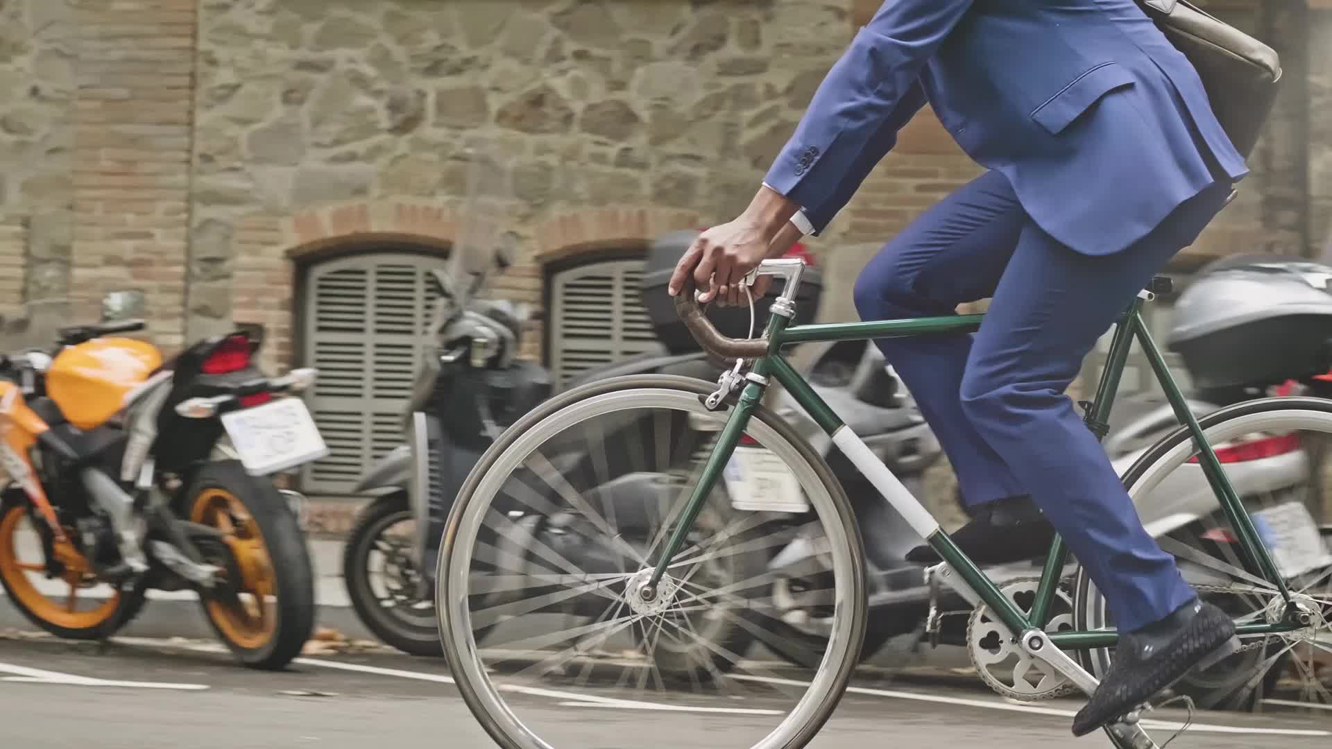
Understanding How Annual Members & Casual Riders Use Cyclistic Bikes Differently
February,2023
Subhamay Basu

Slide 2
Overall Goals
Analyse the past 12 months data to identify trends about bike usage
Analyse the differences in usage habits of the Members and Casual Riders
Design marketing strategies aimed at converting casual riders into annual members

Slide 3

Analysis of Historical Data and its Corresponding Insights

Slide 4
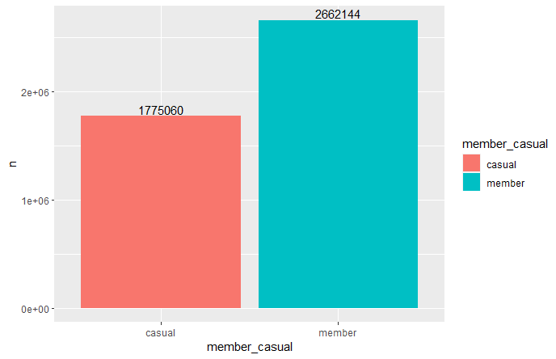
Members Surpass Causal Members in terms of Total Rides taken

Slide 5
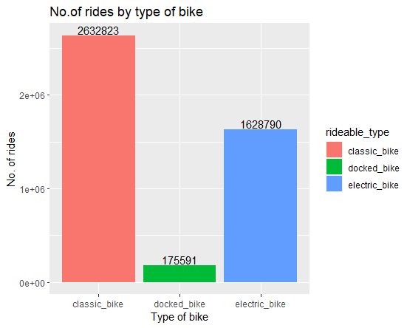
Data would show Classic Bike is the most popular type of rideable among users
Notes:
However, it can also be the case that the number of classic bikes distributed across the city are more than any other type and the data simply reflects that ratio. We would need the ratio of various Rideable Type to say for sure.

Slide 6
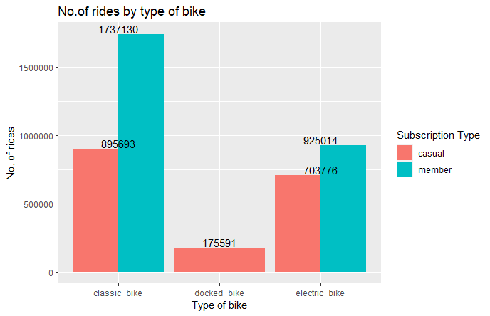
More members prefer the classic bike by a lot and only Casual riders use docked bikes
Notes:
Casual Members don’t seem to have too much preference towards classic bikes over electric bikes. Docked bike seems to be the least popular choice and only casual members use it. [ Docked bikes is probably the name given to the bikes which aren’t standard two wheeler bikes.]

Slide 7
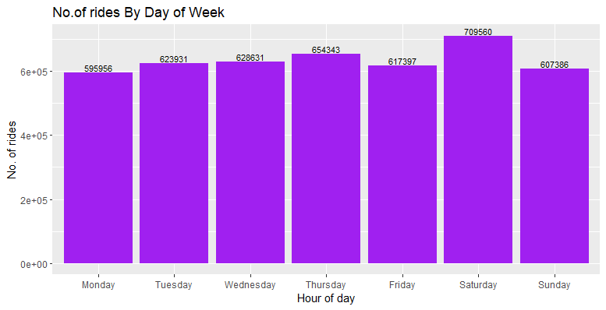
Looking at this it would seem no. of rides don’t vary much by what day it is.

Slide 8
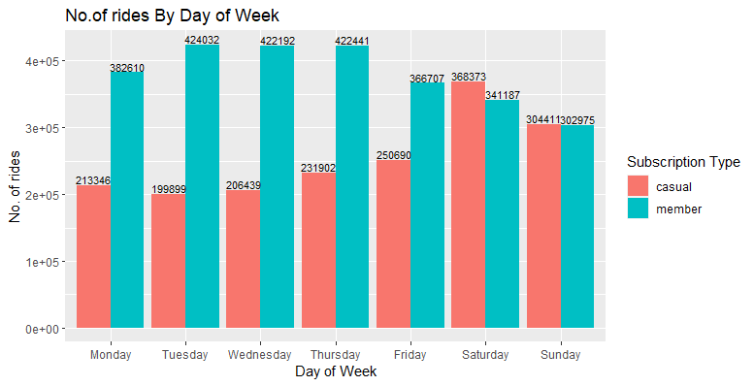
However, Members seem to use a lot more on the weekdays and Casuals seem to use more in the weekends.

Slide 9
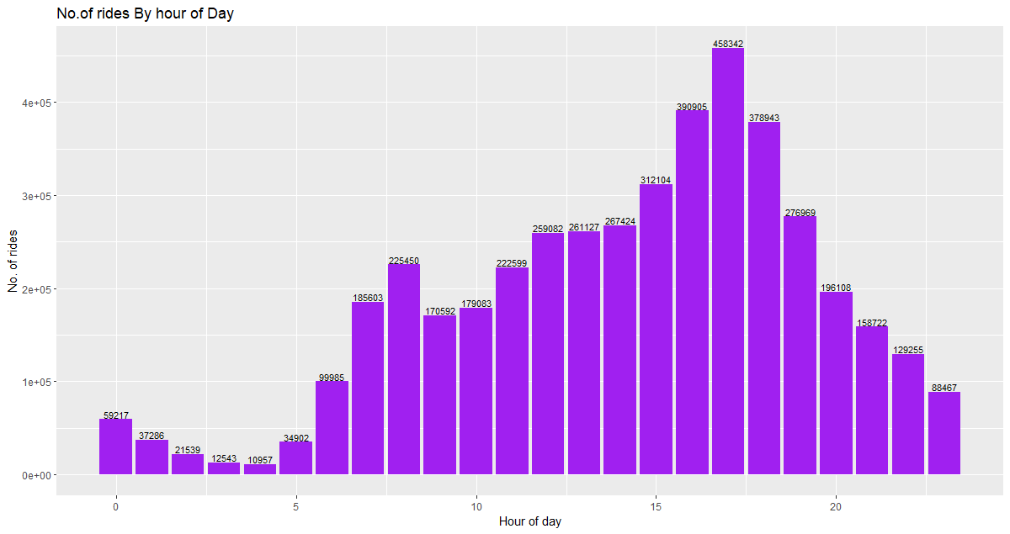
Afternoon is by far the most popular time for riding.

Slide 10
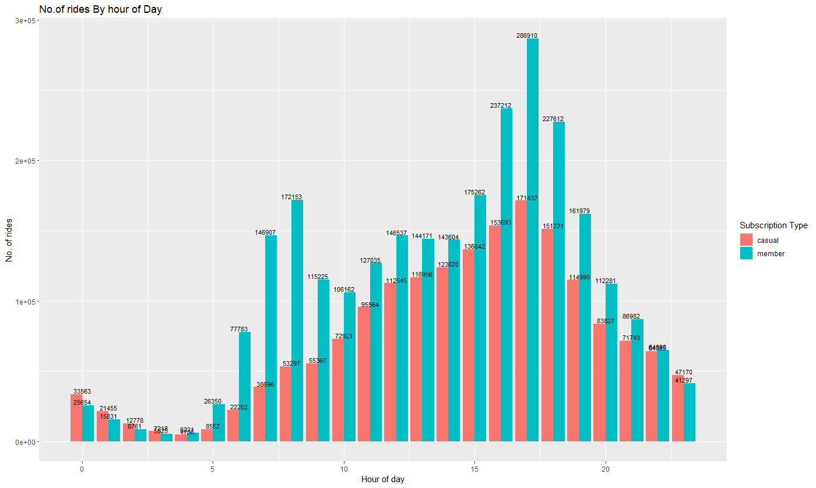
Afternoon is by far the busiest time for for both members and casuals and 5pm is busiest hour
Notes:
A Spike in the morning hours would suggest most members might be using it for going to and from work.

Slide 11
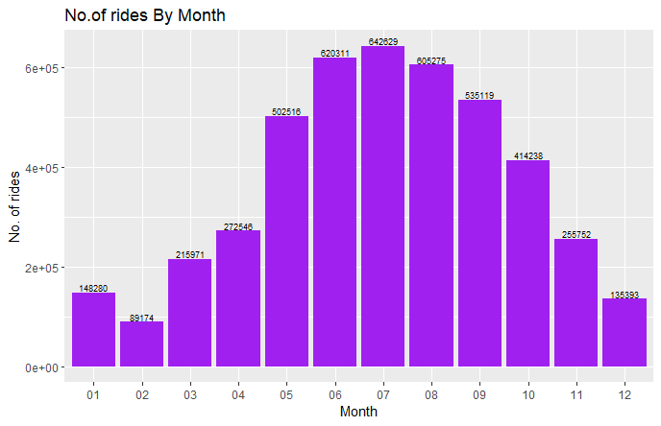
The usage seems to be maximum around Summer season between “May”&”Sep” with July being the busiest month
Notes:
Conversely Winter is the least busy season

Slide 12
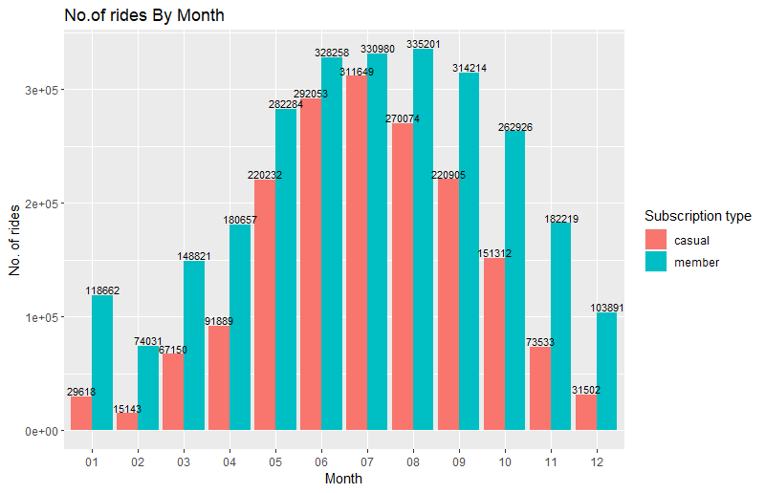
Casual users increase usage by around 2-3 times during warmer months compared to colder months

Slide 13
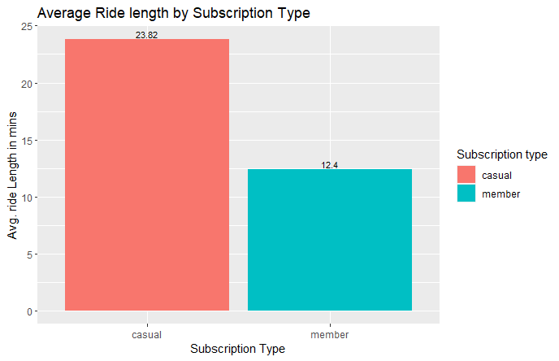
Casual Users ride for longer in general compared to Members

Slide 14
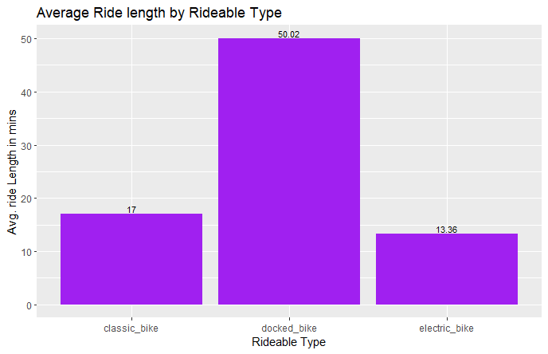
Docked Bike Users use it for more than 3 times longer than any other user.

Slide 15
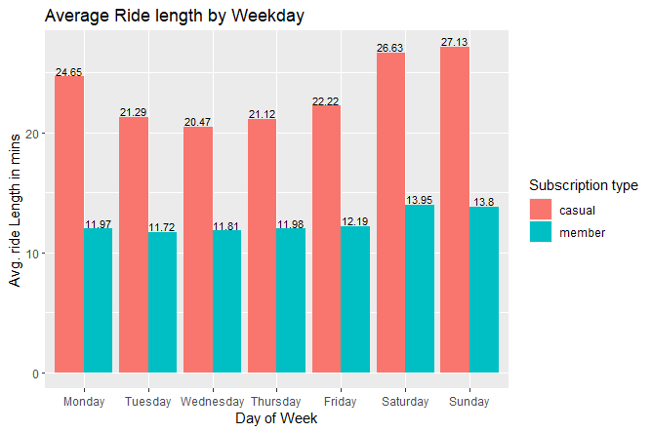
Casual users ride for bit longer during the weekend while members ride for similar times on all days

Slide 16
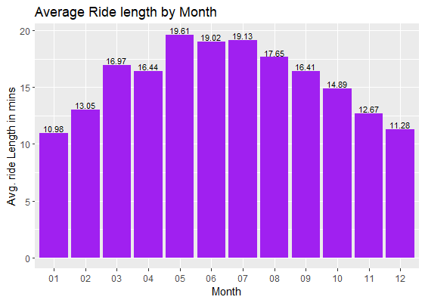
Average ride length follows a similar trend to total number of rides by month

Slide 17
Analysis Insights
Members had the most rides at 60% of total rides. But casual riders rode longer on average at 24 mins while members rode for nearly half as long at 12.5 mins on average
The average ride length mirrored the number of rides , i.e. , they had similar highs and lows(higher during warmer times and lower during colder times)
Both casual riders and members rode maximum during afternoon(12pm - 5 pm) but members show a spike in using during morning(7am - 8am).5pm is the busiest and 4am is the least busy
Saturday was the busiest for both. Members seem to ride for similar times throughout the week although a bit more during the weekend. Casual riders rode the most on weekends followed by Monday, and similar times during rest of the week
Warmer months(May-Sep) was the busiest time for both times of riders July being the busiest month while Winter months(Dec-Feb) was the least busy. There seems to be a correlation between climate and demand.
Most Popular bike: Classic
Busiest time: Afternoon(5pm)
Busiest Day: Saturday
Busiest Season: Summer(July)
Most rides by user type: Members
Average ride length; 17mins
Longest average ride length
by bike type: Docked Bike

Slide 18
Business Recommendations
Weekend membership plan:
Since we have seen that the casual riders travel more in weekends, this type of membership will attract at least those casual riders who avail Cyclistic services every weekend.
Monthly or 3-month membership plan
Since we see that casual riders avail the services more in the warm months, this type of membership will attract casual riders into becoming a member for the busiest 6 months or so.
Discounts for using it longer than 30 mins per ride
This would also attract more casual riders since they usually tend to ride longer and will spend more money by riding a little longer than usual.

